Slide 1
Breast Cancer Prediction {Classification}
AI & MACHINE LEARNING PROJECT
PROJECT MADE BY : PRIYANSHU KUMAR SINGH
SUBMITTED TO : Prutor@IITK

Slide 2
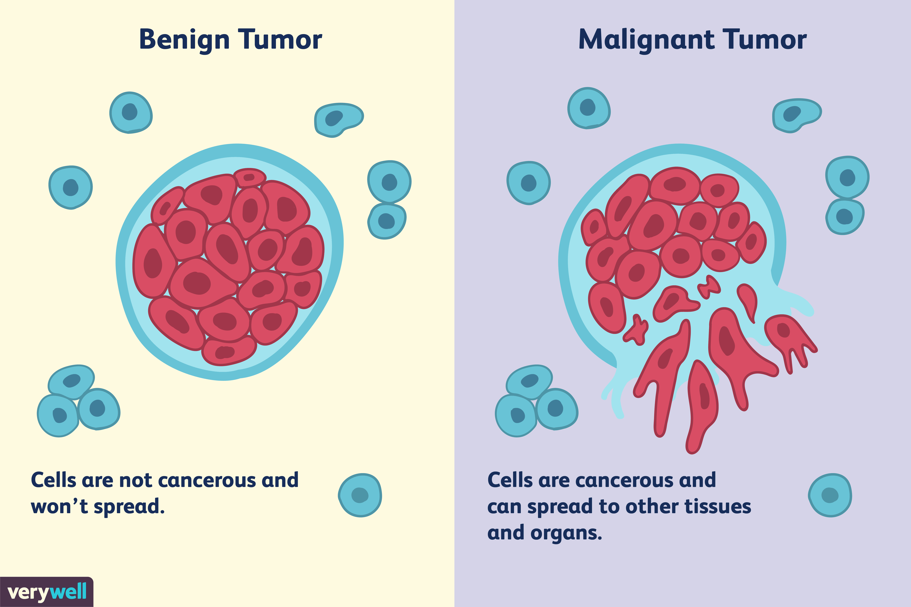
1. Introduction & problem
Breast cancer is a group of diseases in which cells in breast tissue change and divide uncontrolled, typically resulting in a lump or mass. Most breast cancers begin in the lobules (milk glands) or in the ducts that connect the lobules to the nipple.
The key challenge in cancer detection is how to classify tumours into malignant or benign. Machine learning techniques can dramatically improve the accuracy of diagnosis. Research indicates that most experienced physicians can diagnose cancer with 79 percent accuracy while 91 percent correct diagnosis is achieved using machine learning techniques.
In this case study our task is to classify tumours into malignant or benign tumours using features obtained from several cell images. Let us look at the cancer diagnosis and classification process. And at that stage we do not know if that tumour is malignant or benign. The benign tumour is on the lest side and on the right side is the malignant tumour.

Slide 3
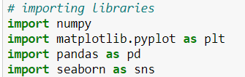
2. LIBRARIES IMPORTED
NUMPY
PANDAS
SEABORN
SKLEARN
MATPLOTLIB

Slide 4
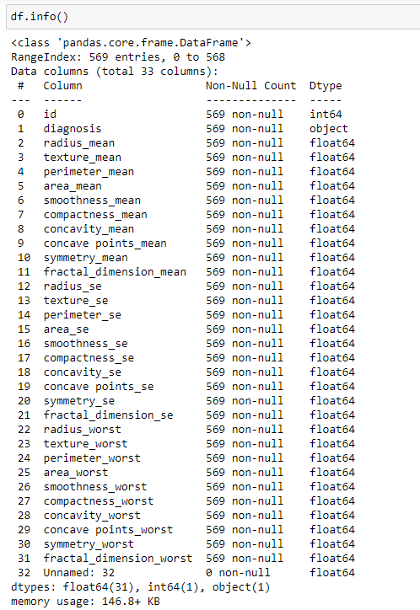
3. Dataset used
The dataset is downloaded from Kaggle and has the data stored for the women's who have either of the two situations whether they have breast cancer or not.
The data has 0 missing values

Slide 5
4. Visualization of our Features
COUNT PLOT
GRAPHICAL REPRESENTATION
HEATMAP

Slide 6
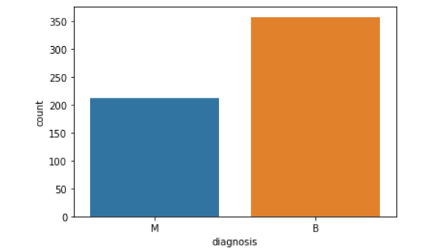
This is a Count Plot of our data.
It simply shows us the count of each of target values, either 0 or 1.
0 represents Malignant tumour
1 represents Benign tumour.

Slide 7
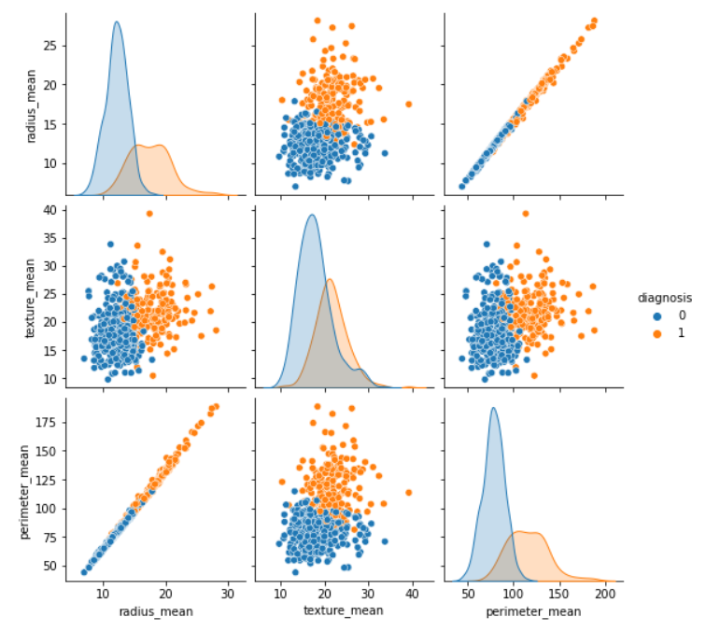
The adjacent figure represents the first 3 features from our data and how they relate to each other.
Note that ‘0’ is for Malignant tumor while’1’ is for Benign tumor.
One of the many observations to see is that mean radius and mean perimeter have a linear relationship.
Whenever the mean area increases wrt mean radius, the chances of a benign cell increases. This means that the patient can be safe.
When the mean smoothness is at the middle, the mean area decides if the cell is benign or malignant. The higher the area, more are the chances of a benign tumour.
This goes on for each and every comparison. Note that we have only compared the first 5 features with each other. We have in total of 30 features.

Slide 8
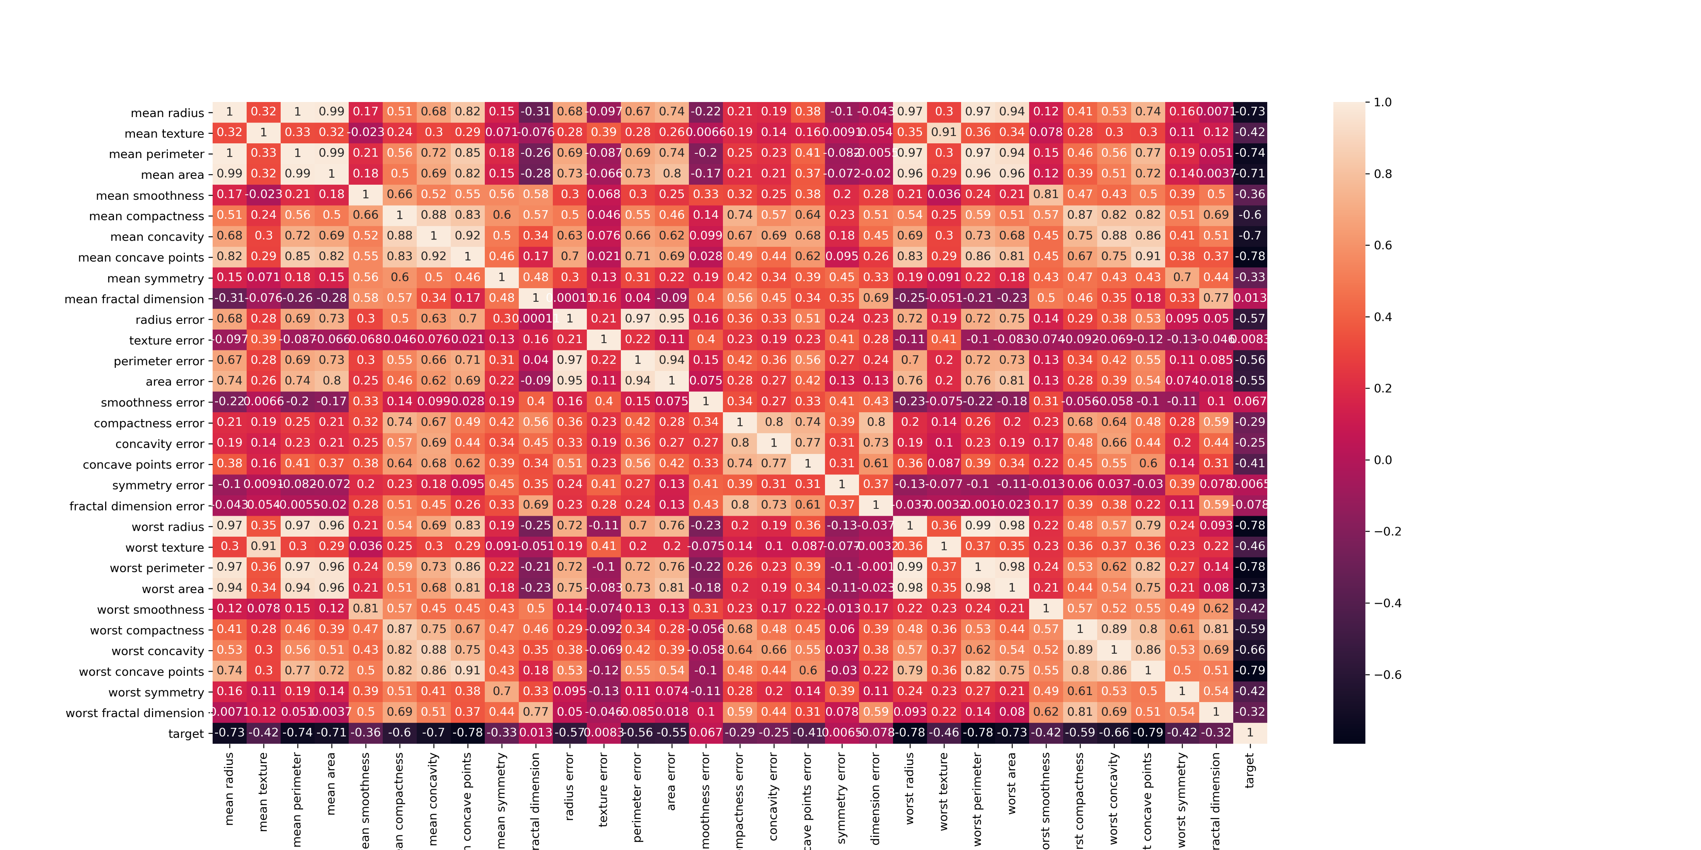
The adjacent figure is a heatmap of our whole dataset including our y variable(feature).
Mean radius, mean perimeter and mean area are one of the most highly correlated points to our worst perimeter feature.
These types of correlations can also be seen with our target variable which is seen in the heatmap.

Slide 9
5. Model Evaluation
LINEAR REGRESSION
DECISION TREE {CLASSIFIER}
RANDOM FOREST { CLASSIFIER}

Slide 10
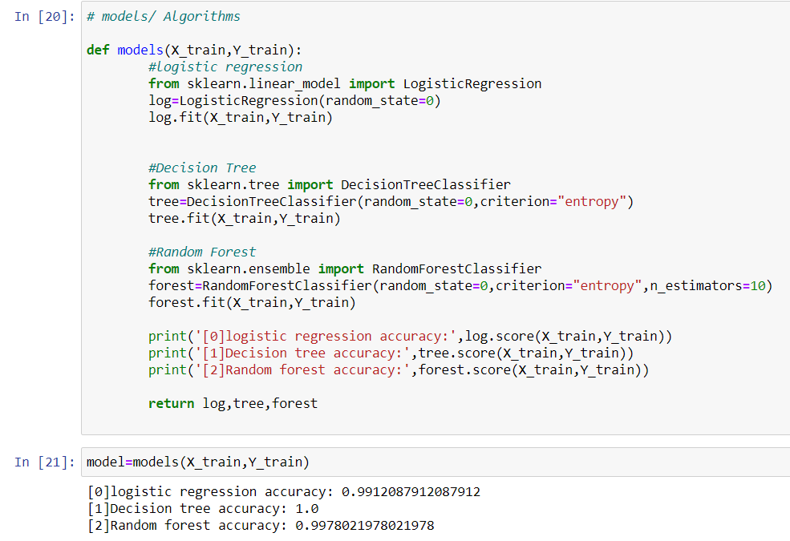
Training accuracy of models
It is done via defining a function through python and sklearn for the three models (Logistic Regression, Decision Tree & Random Forest) to see the training accuracy.
The training accuracy of the models are -
Logistic Regression : 0.9912087912087912
Decision Tree : 1.0
Random Forest : 0.9978021978021978

Slide 11
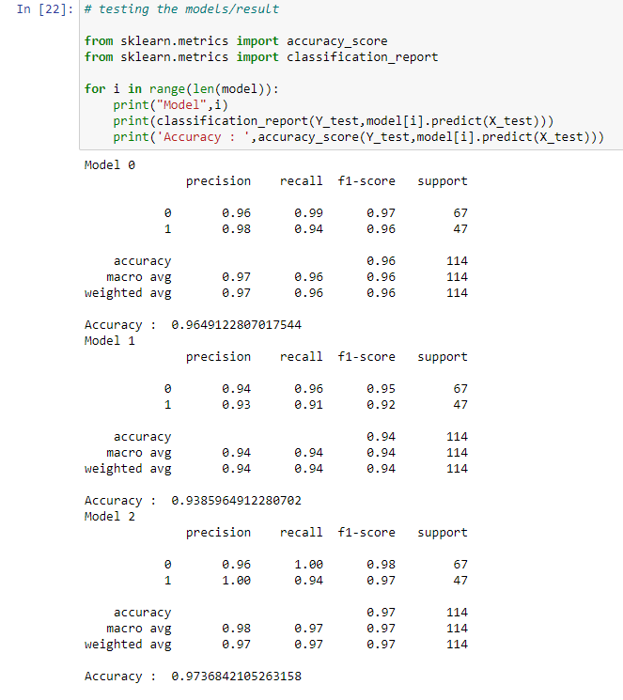
Testing accuracy of models
The testing accuracy of the models are -
Logistic Regression : 0.9649122807017544
Decision Tree : 0.9385964912280702
Random Forest : 0.9736842105263158
Here the model of random forest has the best score/accuracy out of the two given
So we will consider Random forest as the best model.

Slide 12
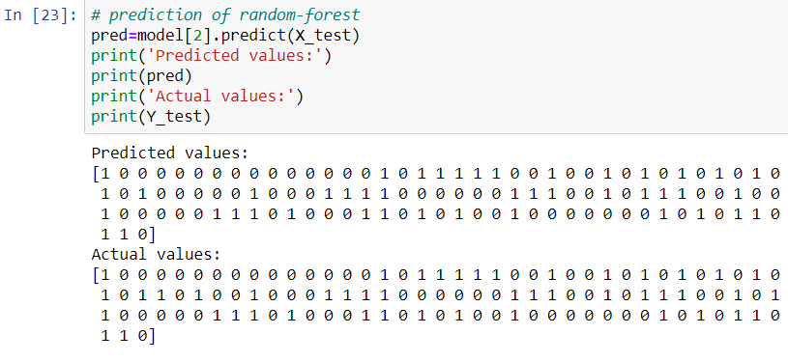
6. Summary : Prediction of the best model
Random Forest Model Score - 0.9736842105263158 (highest score)

